Slide 1
SQL (Structured Query Language)

Slide 2
Contents
Data Retrieval using conditions and sorting
Data Manipulation
Data Definition and Constraints
Joins with examples
Data verification using queries

Slide 3
Contents
Stored procedures
Triggers and their types
User defined function with examples

Slide 4
WHAT IS SQL ?

Slide 5
SQL - Structured Query Language
“Structure Query Language”.
For any operations on the database we need one standard language and SQL serves the purpose for that.
In general, SQL is a language for communicating with the database server to access data.

Slide 6
SQL - Structured Query Language
According to ANSI (American National Standards Institute), it is the standard language for relational database management systems eg: Oracle, Sybase,MS SQL Server, Access etc.
SQL statements are used to perform tasks such as update data on a database, or retrieve data from a database

Slide 7
SQL - Structured Query Language
Although most database systems use SQL, most of them also have their own additional proprietary extensions that are usually only used on their system.
However, the standard SQL commands such as "Select", "Insert", "Update", "Delete", "Create", and "Drop" can be used to accomplish almost everything that one needs to do with a database.

Slide 8
TABLE BASICS

Slide 9
TABLE BASICS
A relational database management system consists one or more objects called Tables.
The data or information for the database are stored in these tables.
Tables are uniquely identified by their names and are comprised of columns and rows.
Columns contain the column name, data type, and any other attributes for the column.
Rows contain the records or data for the columns.

Slide 10

TABLE EXAMPLE

Slide 11
SQL BASICS

Slide 12
SQL Basics: Select, Insert, Update and Delete
SELECT - extracts data from a database
· UPDATE - updates data in a database
· DELETE - deletes data from a database
· INSERT - inserts new data into a database
* SQL is not case sensitive

Slide 13
DATA QUERY LANGUAGE (DQL)

Slide 14
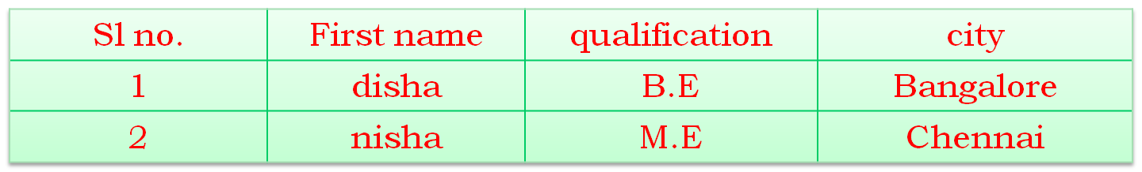
Select Statement (DQL)
Syntax :
SELECT column_name(s) FROM table_name
Example:
Table1

Slide 15
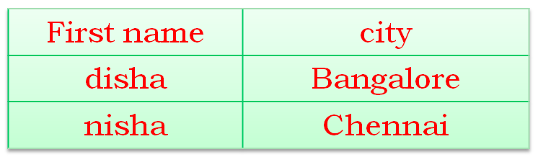
To fetch the content of the columns named "FirstName" and "city" from the prevoius table use:
SELECT FirstName,city FROM Persons
The result sheet looks like this:

Slide 16
SELECT ALL (DQL)
Select * from persons
It will display the entire table as:
Sl no. | First name | qualification | city
1 | disha | B.E | Bangalore
2 | nisha | M.E | Chennai

Slide 17
Using the Comparison Operators
Operator
=
>
>=
<
<=
<>
Meaning
Equal to
Greater than
Greater than or equal to
Less than
Less than or equal to
Not equal to
Notes:
Using the Comparison Operators
Comparison operators are used in conditions that compare one expression to another. They are used in the WHERE clause in the following format:
Syntax
… WHERE expr operator value
Examples
… WHERE hiredate='01-JAN-95'
… WHERE sal>=1500
… WHERE ename='SMITH'

Slide 18
Using the Comparison Operators
SQL> SELECT ename, sal, comm
2 FROM emp
3 WHERE sal<=comm;
ENAME SAL COMM
---------- --------- ---------
MARTIN 1250 1400
Notes:
Using the Comparison Operators
Rows that have a null value in the COMM column result in a null value for the comparison expression and are effectively not part of the result.

Slide 19
Other Comparison Operators
Operator
BETWEEN
...AND...
IN(list)
LIKE
IS NULL
Meaning
Between two values (inclusive)
Match any of a list of values
Match a character pattern
Is a null value

Slide 20
Using the BETWEEN Operator
Use the BETWEEN operator to display rows based on a
range of values.
SQL> SELECT ename, sal
2 FROM emp
3 WHERE sal BETWEEN 1000 AND 1500;
ENAME SAL
---------- ---------
MARTIN 1250
TURNER 1500
WARD 1250
ADAMS 1100
MILLER 1300
Lower
limit
Higher
limit
Notes:
The BETWEEN Operator
The SELECT statement above returns rows from the EMP table for any employee whose salary is between $1000 and $1500. Values specified with the BETWEEN operator are inclusive.

Slide 21
Using the IN Operator
Use the IN operator to test for values in a list.
SQL> SELECT empno, ename, sal, mgr
2 FROM emp
3 WHERE mgr IN (7902, 7566, 7788);
EMPNO ENAME SAL MGR
--------- ---------- --------- ---------
7902 FORD 3000 7566
7369 SMITH 800 7902
7788 SCOTT 3000 7566
7876 ADAMS 1100 7788
Notes:
The IN Operator
The IN operator can be used with any datatype. The following example returns a row from the EMP table for any employee whose name is included in the list of names in the WHERE clause.
SQL> SELECT empno, ename, mgr, deptno
2 FROM emp
3 WHERE ename IN ('FORD' , 'ALLEN');

Slide 22
Using the LIKE Operator
SQL> SELECT ename
2 FROM emp
3 WHERE ename LIKE 'S%';
  You can use the ESCAPE identifier to search for
  "%" or "_".
SQL> SELECT ename
2 FROM emp
3 WHERE ename LIKE '_A%';
ENAME
----------
JAMES
WARD
Notes:
The ESCAPE Option
When you need to have an exact match for the actual "%" and "_" characters, use the ESCAPE option. This option specifies what the ESCAPE character is. To display the names of employees whose name contains "A_B", use the following SQL statement:
The ESCAPE option identifies the backlash (\) as the escape character. In the pattern, the escape character precedes the underscore (_). This causes the Oracle Server to interpret the underscore literally.
SQL> SELECT ename
2 FROM emp
3 WHERE ename LIKE '%A\_%B' ESCAPE '\';

Slide 23
Using the IS NULL Operator
Use the ‘IS NULL’ operator to test for null values
SQL> SELECT ename, mgr
2 FROM emp
3 WHERE mgr IS NULL;
ENAME MGR
---------- ---------
KING
Notes:
The IS NULL Operator
The IS NULL operator tests for values that are null. A null value means the value is unavailable, unassigned, unknown, or inapplicable. Therefore, you cannot test with (=) because a null value cannot be equal or unequal to any value. The example above retrieves the name and manager of all employees who do not have a manager.

Slide 24
Logical Operators
Operator
AND
OR
NOT
Meaning
Returns TRUE if both component conditions are TRUE
Returns TRUE if either component condition is TRUE
Returns TRUE if the following condition is FALSE
Notes:
Using the Logical Operators
A logical operator combines the result of two component conditions to produce a single result based on them or to invert the result of a single condition. Three logical operators are available in SQL:
AND
OR
NOT
All the examples so far have specified only one condition in the WHERE clause. You can use several conditions in one WHERE clause using the AND and OR operators.

Slide 25
Using the AND Operator
AND requires both conditions to be TRUE.
SQL> SELECT empno, ename, job, sal
2 FROM emp
3 WHERE sal>=1100
4 AND job='CLERK';
EMPNO ENAME JOB SAL
--------- ---------- --------- ---------
7876 ADAMS CLERK 1100
7934 MILLER CLERK 1300
Notes:
AND Truth Table

Slide 26
Using the OR Operator
  OR requires either condition to be TRUE.
SQL> SELECT empno, ename, job, sal
2 FROM emp
3 WHERE sal>=1100
4 OR job='CLERK';
EMPNO ENAME JOB SAL
--------- ---------- --------- ---------
7839 KING PRESIDENT 5000
7698 BLAKE MANAGER 2850
7782 CLARK MANAGER 2450
7566 JONES MANAGER 2975
7654 MARTIN SALESMAN 1250
...
14 rows selected.
Notes:
OR Truth Table

Slide 27
Using the NOT Operator
SQL> SELECT ename, job
2 FROM emp
3 WHERE job NOT IN ('CLERK','MANAGER','ANALYST');
ENAME JOB
---------- ---------
KING PRESIDENT
MARTIN SALESMAN
ALLEN SALESMAN
TURNER SALESMAN
WARD SALESMAN
Notes:
NOT Truth Table

Slide 28
DATA MANIPULATION LANGUAGE (DML)

Slide 29
Insert Statement (DML)
Consider Table1 Persons
The table looks like this:
  INSERT INTO Persons
  VALUES (3,'diya','MCA', 'Delhi')
Sl no. | First name | qualification | city
1 | disha | B.E | Bangalore
2 | nisha | M.E | Chennai
3 | diya | MCA | Delhi

Slide 30
Insert Data Only in Specified Columns (DML)
The table looks like this:
  INSERT INTO Persons(sl no., name)VALUES ('4','reya')
Sl no. | First name | qualification | city
1 | disha | B.E | Bangalore
2 | nisha | M.E | Chennai
3 | diya | MCA | Delhi
4 | reya

Slide 31
Update statement(DML)
Consider Table Persons
the table looks like this:
  UPDATE Persons SET qualification ='MS' City='Mumbai'
  WHERE sl no.='4' AND FirstName='reya'
Sl no. | First name | qualification | city
1 | disha | B.E | Bangalore
2 | nisha | M.E | Chennai
3 | diya | MCA | Delhi
4 | reya | MS | Mumbai

Slide 32
Delete statement(DML)
Consider Table Persons
The table looks like this:
  DELETE FROM Persons WHERE firstname='reya' AND sl no.='4'
Sl no. | First name | qualification | city
1 | disha | B.E | Bangalore
2 | nisha | M.E | Chennai
3 | diya | MCA | Delhi

Slide 33
Delete All Rows (DML)
Here we can delete all rows in a table without deleting the table.
Syntax:
DELETE FROM table_name
or
DELETE * FROM table_name
  DELETE FROM Persons

Slide 34
DATA DEFINITION LANGUAGE (DDL)

Slide 35
CREATE (DDL)
Syntax
CREATE TABLE table_nm
(column1 datatype, column2 datatype,column n datatype);
Example:
  Create table persons(Slno int, Firstname varchar(255), qualification varchar(255) ,city varchar(255))

Slide 36
DROP (DDL)
Syntax:
DROP TABLE table_nm
Example:
  DROP TABLE Persons

Slide 37
CONSTRAINTS

Slide 38
CONSTRAINTS
The term constraint means restriction. The database server uses constraints to prevent invalid data entry into tables.
Constraints prevent tables to be deleted if there are dependencies.

Slide 39
NOT NULL(Constraints)
It enforces a field to always contain a value.
The following SQL enforces the "P_Id" column and the "LastName" column to not accept NULL values:
  CREATE TABLE Persons
  (P_Id int NOT NULL,
  LastName varchar(255) NOT NULL,
  FirstName varchar(255),
  City varchar(255))

Slide 40
UNIQUE (Constraint)
It uniquely identifies each record in a database table.The UNIQUE provide a guarantee for uniqueness for a column or set of columns.
The following SQL creates a UNIQUE constraint on the "P_Id„ column when the "Persons" table is created:
  CREATE TABLE Persons
  (P_Id int NOT NULL, LastName varchar(255) NOT NULL, FirstNamevarchar(255),City varchar(255),
  UNIQUE (P_Id))

Slide 41
PRIMARY KEY(Constraint)
Primary keys must contain unique values.
Each table should have a primary key,and each table can have only ONE primary key.
The following SQL creates a PRIMARY KEY on the "P_Id" column when the "Persons" table is created:
  CREATE TABLE Persons
  (P_Id int NOT NULL,
  LastName varchar(255) NOT NULL,
  FirstName varchar(255),
  City varchar(255),
  PRIMARY KEY (P_Id))

Slide 42
FOREIGN KEY(Constraint)
It in one table points to a PRIMARY KEY in another table.
The following SQL creates a FOREIGN KEY on the "P_Id" column when the "Orders" table is created:
  CREATE TABLE Orders
  (
  O_Id int NOT NULL,
  OrderNo int NOT NULL,
  P_Id int,
  PRIMARY KEY (O_Id),
  FOREIGN KEY (P_Id) REFERENCES Persons(P_Id)
  )

Slide 43
CHECK (Constraint)
It is used to limit the value range that can be placed in a column.
The following SQL creates a CHECK constraint on the "P_Id" column when the "Persons" table is created. The CHECK constraint specifies that the column "P_Id" must only include integers greater than 0.
  CREATE TABLE Persons
  (P_Id int NOT NULL,
  LastName varchar(255) NOT NULL,
  FirstName varchar(255),
  City varchar(255),
  CHECK (P_Id>0))

Slide 44
DEFAULT (Constraint)
It is used to insert a default value into column.
The following SQL creates a DEFAULT constraint on the "City" column when the "Persons" table is created:
  CREATE TABLE Persons
  (P_Id int NOT NULL,
  LastName varchar(255) NOT NULL,
  FirstName varchar(255),
  City varchar(255) DEFAULT 'Sandnes')

Slide 45
JOINS

Slide 46
JOINS
The Join Condition is always in the WHERE clause.
Rows in one table can be joined with rows in another table according to the common values existing in the corresponding columns, which is usually the primary key and foreign key columns.

Slide 47
INNER JOIN
The INNER JOIN keyword return rows when there is at least one match in both tables.
Syntax:
SELECT column_name(s) FROM table_name1 INNER JOIN table_name2 ON table_name1. column_name= table_name2.column_name
  SELECT Persons.LastName, Persons.FirstName, Orders.OrderNo
  FROM Persons
  INNER JOIN Orders
  ON Persons.P_Id=Orders.P_Id
  ORDER BY Persons.LastName

Slide 48
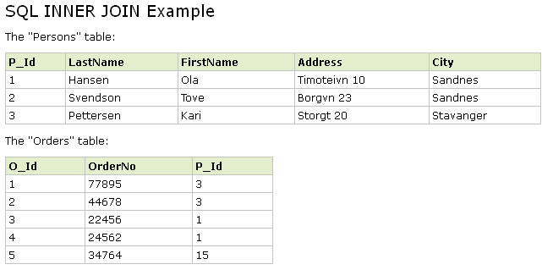
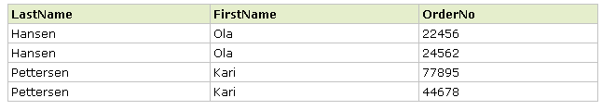
The result sheet looks like this:

Slide 49
LEFT JOIN
The LEFT JOIN keyword returns all rows from the left table (table_name1), even if there are no matches in the right table (table_name2).
Syntax:
SELECT column_name(s) FROM table_name1
LEFT JOIN table_name2 ON table_name1. column_name=table_name2.column_name
  SELECT Persons.LastName, Persons.FirstName, Orders.OrderNo
  FROM Persons
  LEFT JOIN Orders
  ON Persons.P_Id=Orders.P_Id
  ORDER BY Persons.LastName

Slide 50
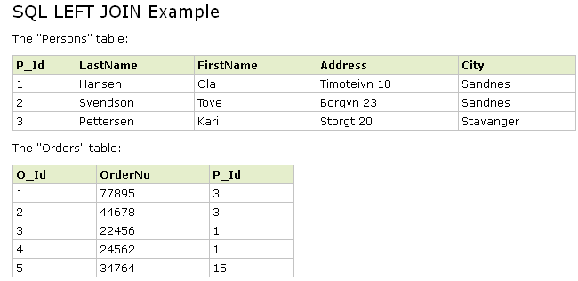
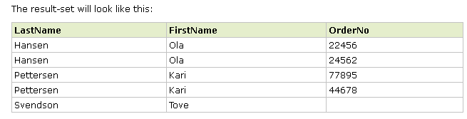

Slide 51
RIGHT JOIN
The RIGHT JOIN keyword returns all the rows from the right table (table_name2), even if there are no matches in the left table (table_name1).
Syntax:
SELECT column_name(s) FROM table_name1
RIGHT JOIN table_name2 ON table_name1. column_name= table_name2.column_name
  SELECT Persons.LastName, Persons.FirstName, Orders.OrderNo
  FROM Persons
  RIGHT JOIN Orders
  ON Persons.P_Id=Orders.P_Id
  ORDER BY Persons.LastName

Slide 52
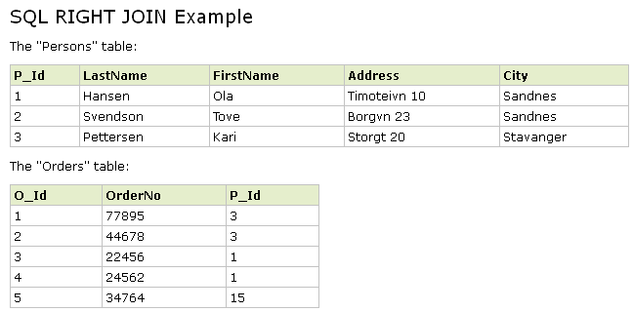
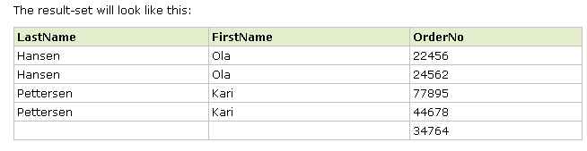

Slide 53
FULL JOIN
The FULL JOIN keyword return rows when there is a match in one of the tables. Syntax:
SELECT column_name(s) FROM table_name1
FULL JOIN table_name2 ON table_name1. column_name=table_name2.column_name
  SELECT Persons.LastName, Persons.FirstName, Orders.OrderNo
  FROM Persons
  FULL JOIN Orders
  ON Persons.P_Id=Orders.P_Id
  ORDER BY Persons.LastName

Slide 54
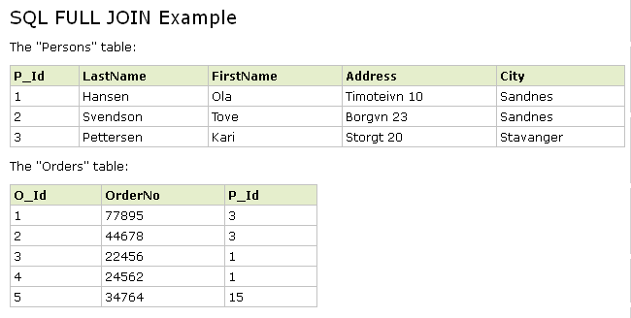
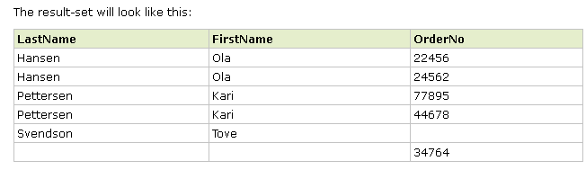

Slide 55
STORED PROCEDURES

Slide 56
Creating stored procedures
General Syntax to create a procedure is:
CREATE PROCEDURE proc_name [list of parameters]
IS
Declaration section
BEGIN
Execution section
EXCEPTION
Exception section
END;

Slide 57
The below example creates a procedure ‘getPersons’ which gives the details of the persons belonging to a particular city.
  CREATE PROCEDURE getPersons
  @city varchar(50)
  AS
  BEGIN
  SELECT *
  FROM Persons
  WHERE City = @city
  RETURN @@ROWCOUNT;
  END
  GO
Notes:
@@rowcount returns the no. of rows affected by the last executed query.

Slide 58
Executing Stored Procedures
Use the command Execute to invoke a stored procedure.
A stored procedure can return an integer value. To retrieve the return value:
  EXEC[UTE] getPersons @city='agnes'
  DECLARE @i INT
  EXEC @i=getPersons @city='agnes'
  SELECT @i

Slide 59
BUILT-IN USER DEFINED FUNCTIONS

Slide 60
SQL Aggregate Functions
SQL aggregate functions return a single value, calculated from values in a column.
AVG() - Returns the average value
Syntax:
SELECT AVG(column_name) FROM table_name

Slide 61
COUNT() - Returns the number of rows
Syntax:
SELECT COUNT(column_name) FROM table_name
SUM() - Returns the sum
Syntax:
SELECT SUM(column_name) FROM tab

Slide 62
MAX() - Returns the largest value
Syntax:
SELECT MAX(column_name) FROM table_name
MIN() - Returns the smallest value
Syntax:
SELECT MIN(column_name) FROM table_name

Slide 63
SQL Functions:avg
We have the following "Orders" table:
O_Id | OrderDate | OrderPrice | Customer
1 | 2008/11/12 | 1000 | Hansen
2 | 2008/10/23 | 1600 | Nilsen
3 | 2008/09/02 | 700 | Hansen
4 | 2008/09/03 | 300 | Hansen
5 | 2008/08/30 | 2000 | Jensen
6 | 2008/10/04 | 100 | Nilsen

Slide 64
Now we want to find the average value of the "OrderPrice" fields.
SELECT AVG(OrderPrice) AS OrderAverage FROM Orders
The result-set will look like this:
OrderAverage
950

Slide 65
SQL Functions:count
O_Id | OrderDate | OrderPrice | Customer
1 | 2008/11/12 | 1000 | Hansen
2 | 2008/10/23 | 1600 | Nilsen
3 | 2008/09/02 | 700 | Hansen
4 | 2008/09/03 | 300 | Hansen
5 | 2008/08/30 | 2000 | Jensen
6 | 2008/10/04 | 100 | Nilsen
SELECT COUNT(Customer) AS CustomerNilsen FROM Orders WHERE Customer='Nilsen'
CustomerNilsen
2

Slide 66
SQL Functions:max
O_Id | OrderDate | OrderPrice | Customer
1 | 2008/11/12 | 1000 | Hansen
2 | 2008/10/23 | 1600 | Nilsen
3 | 2008/09/02 | 700 | Hansen
4 | 2008/09/03 | 300 | Hansen
5 | 2008/08/30 | 2000 | Jensen
6 | 2008/10/04 | 100 | Nilsen
SELECT MAX(OrderPrice) AS LargestOrderPrice FROM Orders
LargestOrderPrice
2000

Slide 67
SQL Functions:Min
O_Id | OrderDate | OrderPrice | Customer
1 | 2008/11/12 | 1000 | Hansen
2 | 2008/10/23 | 1600 | Nilsen
3 | 2008/09/02 | 700 | Hansen
4 | 2008/09/03 | 300 | Hansen
5 | 2008/08/30 | 2000 | Jensen
6 | 2008/10/04 | 100 | Nilsen
SELECT MIN(OrderPrice) AS SmallestOrderPrice FROM Orders
SmallestOrderPrice
100

Slide 68
SQL Functions:sum
O_Id | OrderDate | OrderPrice | Customer
1 | 2008/11/12 | 1000 | Hansen
2 | 2008/10/23 | 1600 | Nilsen
3 | 2008/09/02 | 700 | Hansen
4 | 2008/09/03 | 300 | Hansen
5 | 2008/08/30 | 2000 | Jensen
6 | 2008/10/04 | 100 | Nilsen
SELECT SUM(OrderPrice) AS OrderTotal FROM Orders
OrderTotal
5700

Slide 69
SQL Functions:group by
O_Id | OrderDate | OrderPrice | Customer
1 | 2008/11/12 | 1000 | Hansen
2 | 2008/10/23 | 1600 | Nilsen
3 | 2008/09/02 | 700 | Hansen
4 | 2008/09/03 | 300 | Hansen
5 | 2008/08/30 | 2000 | Jensen
6 | 2008/10/04 | 100 | Nilsen
Customer | SUM(OrderPrice)
Hansen | 2000
Nilsen | 1700
Jensen | 2000
SELECT Customer,SUM(OrderPrice) FROM Orders GROUP BY Customer
SELECT Customer, SUM(OrderPrice) FROM Orders
Customer | SUM(OrderPrice)
Hansen | 5700
Nilsen | 5700
Hansen | 5700
Hansen | 5700
Jensen | 5700
Nilsen | 5700

Slide 70
SQL Functions:having()
O_Id | OrderDate | OrderPrice | Customer
1 | 2008/11/12 | 1000 | Hansen
2 | 2008/10/23 | 1600 | Nilsen
3 | 2008/09/02 | 700 | Hansen
4 | 2008/09/03 | 300 | Hansen
5 | 2008/08/30 | 2000 | Jensen
6 | 2008/10/04 | 100 | Nilsen
SELECT Customer,SUM(OrderPrice) FROM Orders GROUP BY Customer HAVING SUM(OrderPrice)<2000
Customer | SUM(OrderPrice)
Nilsen | 1700

Slide 71
SQL Scalar functions
SQL scalar functions return a single value,
based on the input value.
UPPER() - Converts a field to upper case
Syntax:
SELECT UPPER(column_name) FROM table_name

Slide 72
LOWER() - Converts a field to lower case
Syntax:
SELECT LOWER(column_name) FROM table_name
GETDATE() - Returns the current system date and time
Syntax:
SELECT GETDATE() FROM table_name

Slide 73
LEN() - Returns the length of a text field
Syntax:
SELECT LEN(column_name) FROM table_name
ROUND() - Rounds a numeric field to the number of decimals specified
Syntax:
SELECT ROUND(column_name,decimals) FROM table_name

Slide 74
SQL Functions:UPPER
P_Id | LastName | FirstName | Address | City
1 | Hansen | Ola | Timoteivn 10 | Sandnes
2 | Svendson | Tove | Borgvn 23 | Sandnes
3 | Pettersen | Kari | Storgt 20 | Stavanger
SELECT UPPER(LastName) as LastName,FirstName FROM Persons
LastName | FirstName
HANSEN | Ola
SVENDSON | Tove
PETTERSEN | Kari

Slide 75
SQL Functions:LOWER
P_Id | LastName | FirstName | Address | City
1 | Hansen | Ola | Timoteivn 10 | Sandnes
2 | Svendson | Tove | Borgvn 23 | Sandnes
3 | Pettersen | Kari | Storgt 20 | Stavanger
SELECT LOWER(LastName) as LastName, FirstName FROM Persons
LastName | FirstName
hansen | Ola
svendson | Tove
pettersen | Kari

Slide 76
SQL Functions:len
P_Id | LastName | FirstName | Address | City
1 | Hansen | Ola | Timoteivn 10 | Sandnes
2 | Svendson | Tove | Borgvn 23 | Sandnes
3 | Pettersen | Kari | Storgt 20 | Stavanger
SELECT LEN(Address) as LengthOfAddress FROM Persons
LengthOfAddress
12
9
9

Slide 77
Syntax:
getdate()
Example:
select getdate()
Syntax:
round(numeric_expression , length)
Example:
select round(56778.566545,2)

Slide 78
Transaction Control Language (TCL)
A transaction is a collection of DML statements which forms a logical unit of work.
The basic commands that are used in Transaction Control Language are as follows.
    COMMIT: It ends the transaction by making all pending data changes permanent.
    ROLLBACK: It ends the current transaction by discarding all pending data changes.

Slide 79
TRIGGERS

Slide 80
Trigger Creation
Syntax:
CREATE TRIGGER trigger_name
ON table_name
{FOR/INSTEAD OF / AFTER} [INSERT/UPDATE/DELETE] AS
IF UPDATE(column_name)
[{AND/OR} UPDATE(COLUMN_NAME)...]
{ sql_statements };

Slide 81
Example: Update Trigger
  CREATE TRIGGER trigger1 ON Employee
  FOR UPDATE
  AS
  IF UPDATE(employee_id)
  BEGIN
  PRINT 'Transaction not processed'
  ROLLBACK TRANSACTION
  END

Slide 82
Trigger tables
Operation | deleted Table | inserted Table
INSERT | (not used) | Contains the rows being inserted
DELETE | Contains the rows being deleted | (not used)
UPDATE | Contains the rows as they were before the UPDATE statement | Contains the rows as they were after the UPDATE statement

Slide 83
Example: Trigger tables
  CREATE TRIGGER trigger1 ON Employees
  FOR UPDATE
  AS
  IF UPDATE(hiredate)
  BEGIN
  IF( SELECT hiredate FROM INSERTED ) < ( SELECT hiredate FROM DELETED )
  BEGIN
  PRINT 'Transaction not processed'
  ROLLBACK TRANSACTION
  END
  END

Slide 84
Trigger guidelines
A table can have only three triggers action per table: UPDATE, INSERT and DELETE.
AFTER trigger cannot be created on a view but can reference them.
A trigger should not include SELECT statements that return results to the user.
On dropping a table all triggers associated to the tables are automatically dropped.

